Slide 1

Mood Disorders

Slide 2
Mood Disorders
Mood disorders are common, rather than rare
20% of will experience a mood disorder in lifetime
Recall: statistical rarity definition of abnormality
Examples (but not exhaustive list)
Major Depressive disorder
Dysthymia
Bipolar disorder
Seasonal affective disorder
Post Partum depression

Slide 3
Mood Disorders: Depression and Mania
Bipolar disorder: Disordered mood shifts in two directions, from depression to manic state
For diagnosis, must have experienced atleast one manic episode
Manic state: “elevated, expansive, or irritable mood” (Nolen-Hoeksema & Rector, 2008; p.296)
Person becomes hyperactive, talkative, decreased need for sleep
May engage in activities that are self-destructive or dangerous, such as spending sprees, risk-taking, inflated self- esteem/grandiosity, racing thoughts & speech, increase in activity directed at achieving goals (Nolen-Hoeksema & Rector, 2008; p.296
Manic state must last at least a week to be classified as such, but may last for months

Slide 4
Major Depressive Episode
Five or more of these symptoms for at least 2 weeks:
Depressed mood for most of the day
Loss of interest in normal daily activities
Significant weight change
Change in activity level
Daily fatigue or loss of energy
Negative self-concept (worthlessness; excessive guilt)
Trouble concentrating or making decisions
Suicidal thoughts
Symptoms do not meet criteria for a mixed episode (i.e. mania plus depression)

Slide 5
Risk of self-harm increases when a person is depressed
Threats of self-harm should be taken seriously
Recall criterion of “Danger”

Slide 6
Major Depressive disorder
Symptoms causes significant distress or impairment in
Social
Occupational
Other areas of functioning
Symptoms not due to medical conditions
E.g. Hypothyroidism
Major depression tends to recurrent
Dysthymia refers to lower grade, chronic depression (for atleast 2 years)
“double depression” = dysthymia plus major episodes

Slide 7
Possible Explanations for Depression
Life events, especially loss and separation
Social Learning factors and Behaviourist perspective
Depressed individuals seek out a lot of reassurance
However, their behaviour elicits negative reactions from others
Difficult to receive positive reinforcement from others
Tend to receive “punishments”
E.g. Coyne (1976) Students who spoke on the phone with depressed individuals were
Themselves more depressed, anxious, hostile
...compared to those who spoke to non-depressed people.
Students less likely to report an interest in speaking to the person in the future.

Slide 8
Explanations (cont’d): The Role of Thinking
Aaron Beck (1987)
Depression is maintained by negative beliefs and expectations
Depressed people use
“Depressive Triad”
Negative views about oneself, the world, & the future
Negative Schemas
Stress can activate negative schemas
Depressed person attends to, and encodes information consistent with negative schemas
Affirms poor self concept

Slide 9
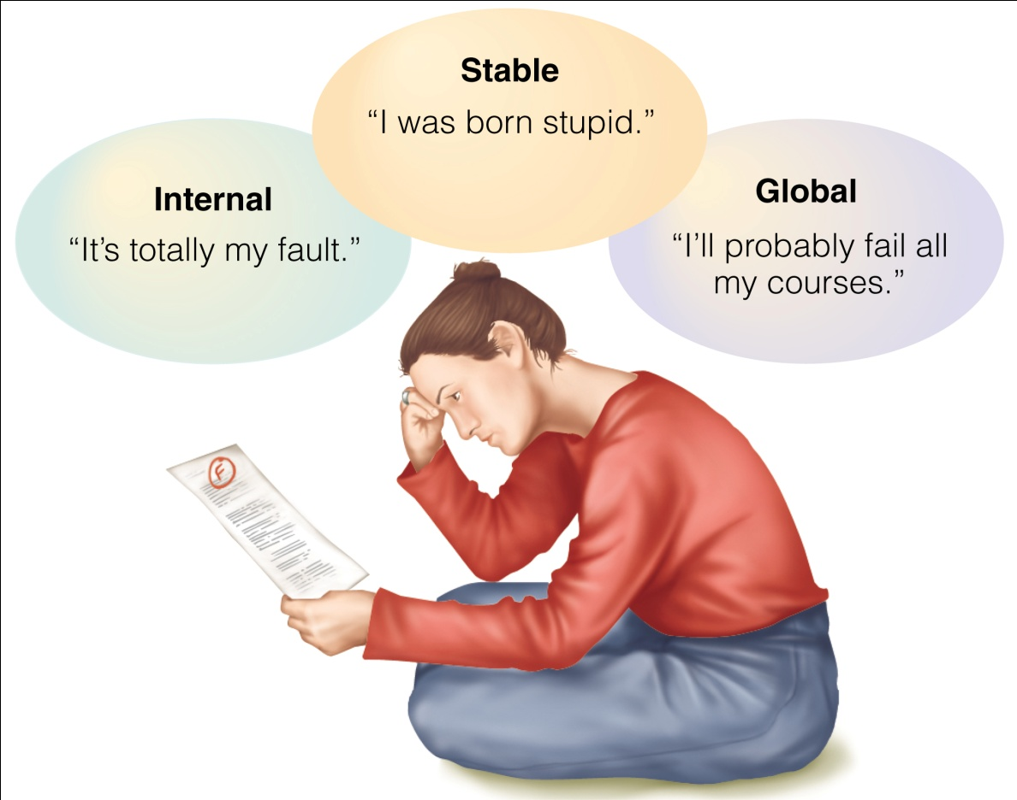

Cognitive Distortions in Depression
Overgeneralization
Making sweeping conclusions
E.g. “nothing will ever go right for me”
Selective abstraction
E.g. Singling out one part of a situation and making attribution based only on that
Figure 14.7
Compared to non-depressed people, depressed people tend to make the above attributions for “failures”

Slide 10
The role of thinking (Cont’d)
“Depressive realism”
Although there are cognitive distortions related to failures, depressed people may be more realistic compared to non-depressed
no sense of illusory control (but keep in mind some illusory control is beneficial)

Slide 11
Explanations: Learned Helplessness
Martin Seligman (1975)
Learned Helplessness
Tendency to feel helpless and hopeless in situations not under our control
Seligman’s studies with dogs and electric shock floorboards
Dogs who were not allowed to escape initially showed LH
Became passive after experiencing repeated failures

Slide 12
Explanations: Biology
Evidence for genetic influences based on twin and family studies
Major Depression: 40% concordance for MZ twins, compared to 11% for DZ
Bipolar disorder: As high as 85% concordance for MZ twins reported

Slide 13
Brain and Biochemical Factors
Bipolar Disorder
Major Depression
High levels of norepinephrine
Sleep deprivation appears to be a trigger for manic episodes
dopamine receptors are oversensitive
Increased activity in amygdala
Decreased activity in prefrontal cortex
Norepinephrine (low levels)
Dopamine (low levels)
Can account for loss of pleasure in life
Serotonin (low levels)
SERT gene is structured differently in people with depression compared to non-depressed

Slide 14
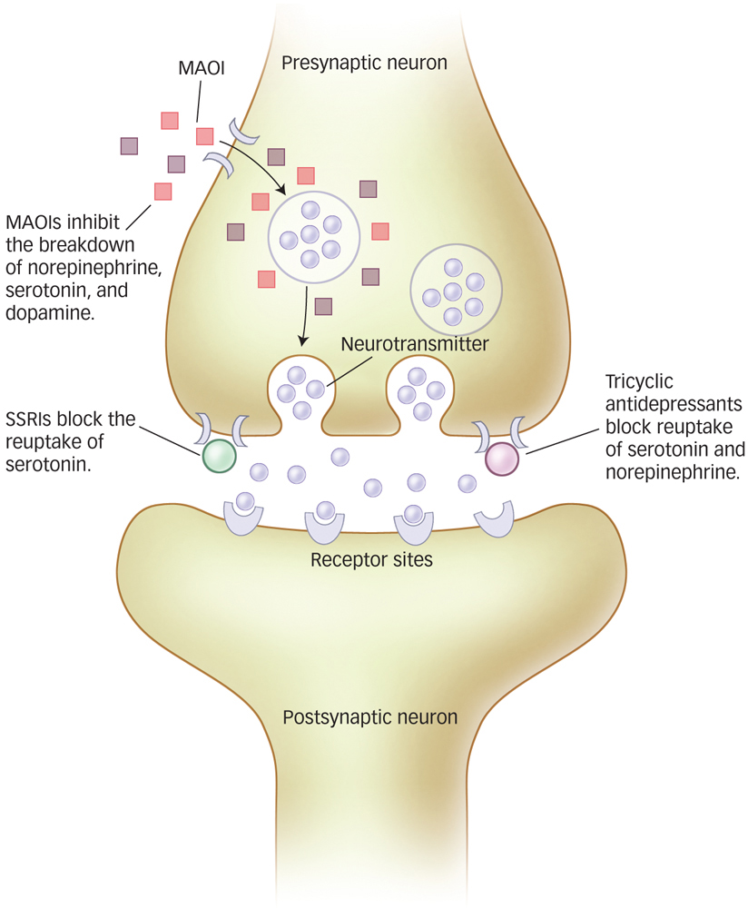
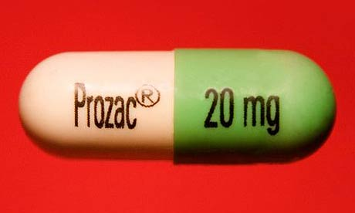
Antidepressant Drug Actions
monoamine oxidase inhibitors (MAOIs) prevent MAO from breaking down NOREP, SER, DOP
Selective serotonin reuptake inhibitors (SSRIs)
E.g. Prozac, lexapro
(Tri)Cyclics Block reuptake of SER, NOREP

Slide 15
Mood stabilizers used to treat bipolar disorder
Used to reduce likelihood of swings between depression and mania
E.g. Lithium Carbonate decreases NOR

Slide 16
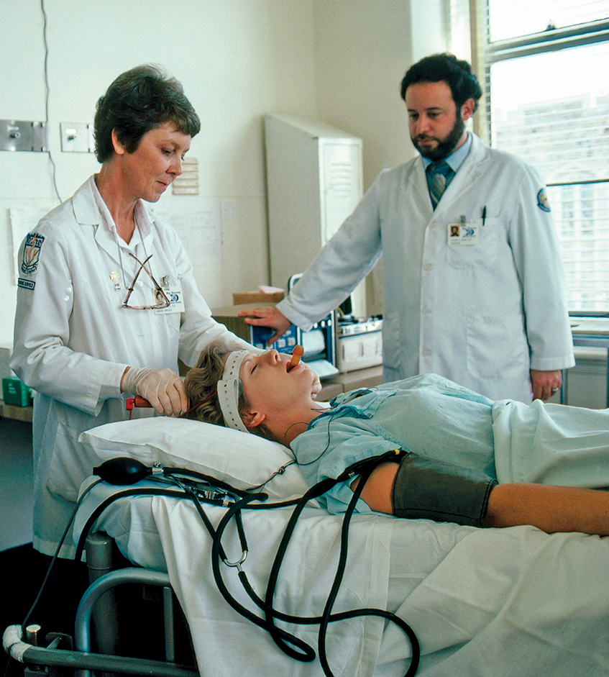
Biological Treatments Beyond Medication
ECT: a brain seizure is induced using electrical pulses
Used mainly for depression when all other methods of treatment have not worked
Side effects: confusion and poor memory after procedure
Electroconvulsive Therapy

Slide 17
ECT is also used for cases of bipolar disorder, and schizophrenia
6-10 treatments, about three times a week
It is not entirely clear why or how ECT works for major depression
But it appears to boost serotonin levels

Slide 18

Cognitive Therapies
Goal: Remove irrational beliefs, negative thoughts presumed to be responsible for maintaining depression
Techniques:
Identify irrational beliefs
Identify maladaptive interpretations of events
Challenge beliefs directly
Encourage more rational beliefs and interpretations

Slide 19

Albert Ellis’ Rational Emotive Therapy
A = adversity/fact of reality
B = beliefs about A
C= consequences derived from B
D & E added later
D = dispute irrational beliefs
E = more effective beliefs

Slide 20
Beck’s Cognitive Therapy
Encourages clients to identify irrational thought processes themselves
Record keeping or “homework” is often used to pinpoint thought processes that lead to negative emotions
Identifying automatic negative thoughts
E.g. “I’m incompetent”, “People don’t like me”
In addition, client writes out a more adaptive, rational response that counters the automatic thought

Slide 21
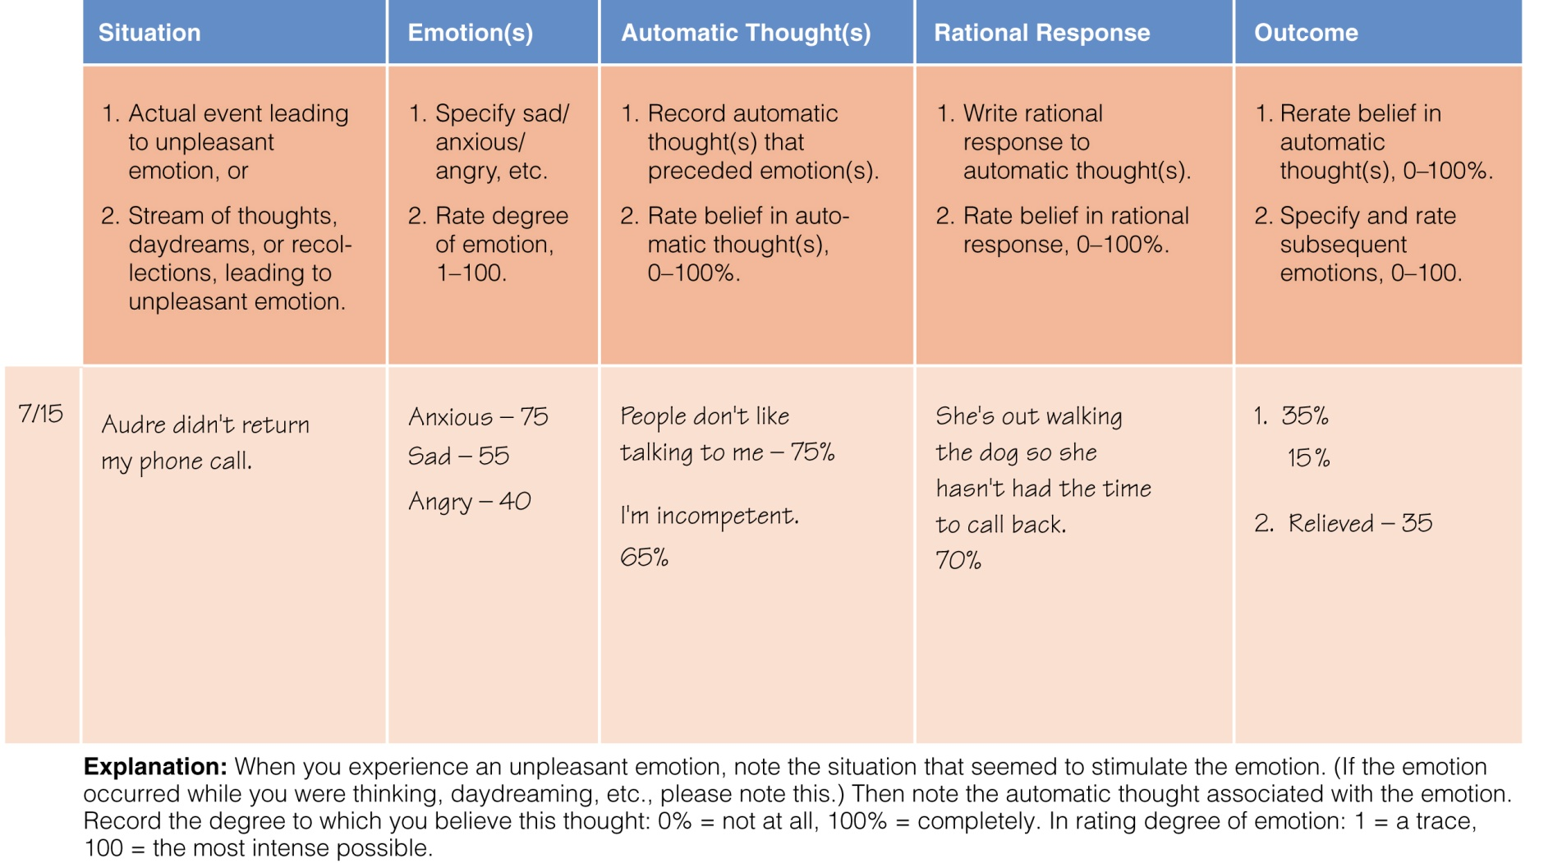
Homework from a Cognitive Therapist
Figure 15.6

